Slide 1

YouTube - Statistics by Genre
GWU Data Analytics Bootcamp 2024

Slide 2
Project Information
Project Team (Group One)
Analyzed Attributes
Austin Lee, Dawson Martin-Jones, & Gboyega Adega
-View Count
-Like Count
-Comment Count
-Trending Videos
Project Scope
Our goal is to analyze different metrics within Youtube to see which Youtube genres are the most popular and receive the most interactions.

Slide 3
Main Objective
Is there significant difference of popularity between the different genres on youtube?
Which genre gets the most traction?
Which genre gets the least amount of interaction?
Does the view count correlate with the like count?
Does the view count correlate with the comment count?
How we will address this?
Depicting visual data representations to show the most popular genres and how the view counts correlate with the likes and comments.
Bar graphs, scatter charts, heat map, and pie charts.

Slide 4

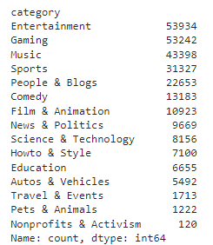
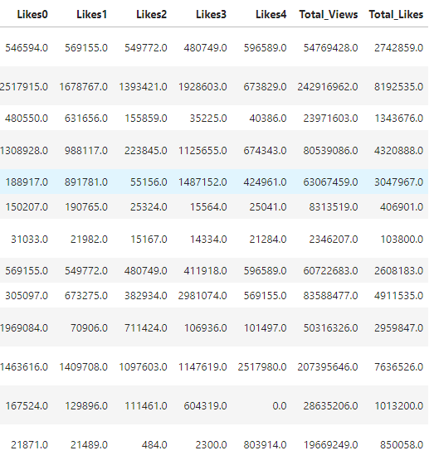
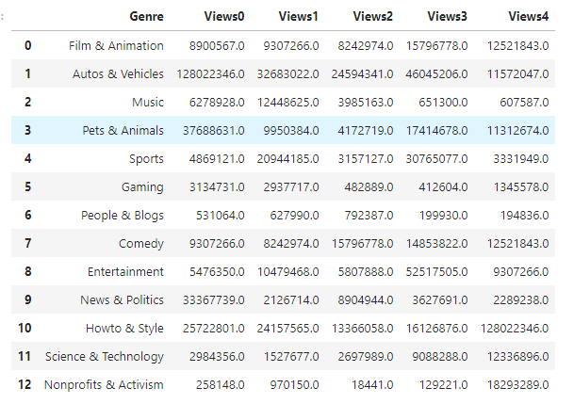
Data Cleanup
Importing the json file containing the key to The category ID’s to convert the number into categories and make it readable.
Merging dataframes to get values needed to create visualizations.

Slide 5
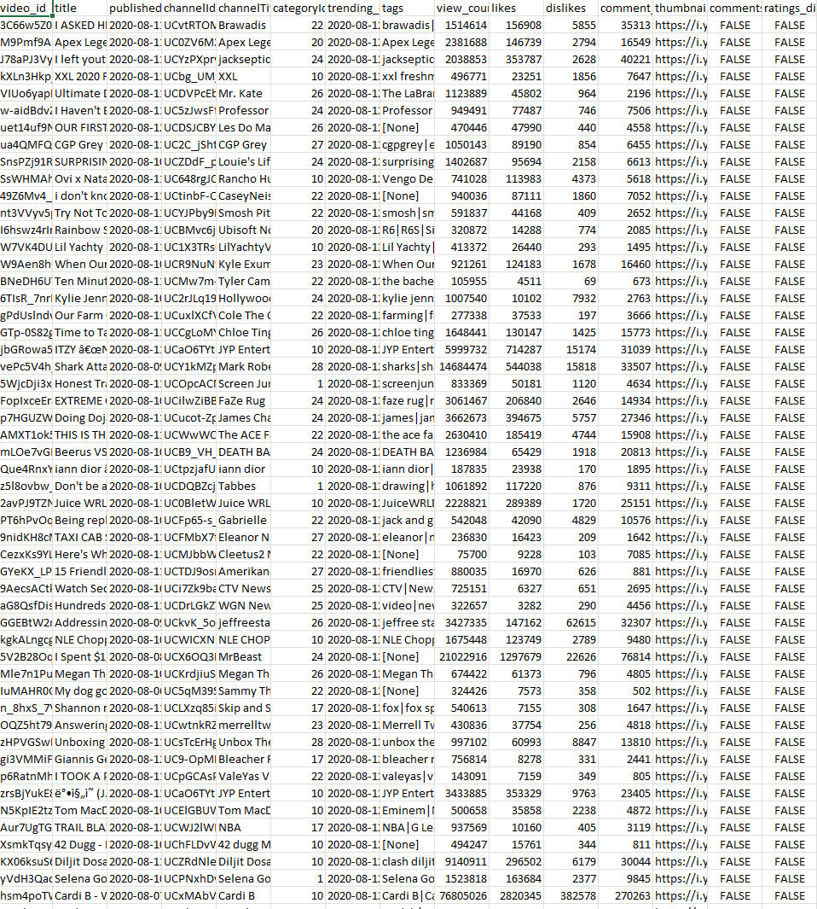
Data Sources
Data Retrieval
We used two types of data from different sources, and one json file to filter categories.
.csv - Found from Kaggle
YouTube Trending Video Dataset (updated daily)
json file
https://www.kaggle.com/datasets/rsrishav/youtube-trending-video-dataset
API - Youtube API: Changes Daily
Search: list | YouTube Data API | Google for Developers
Through using these three data sources we were able to find the top genres that were in the trending list in the year 2020 and currently. The top genre came out to be the entertainment genre.
Unfortunately we were limited to the most popular videos of today due to restrictions in Youtube’s API, however we were still able to analyze a large amount of video’s and different metrics within these videos.

Slide 6
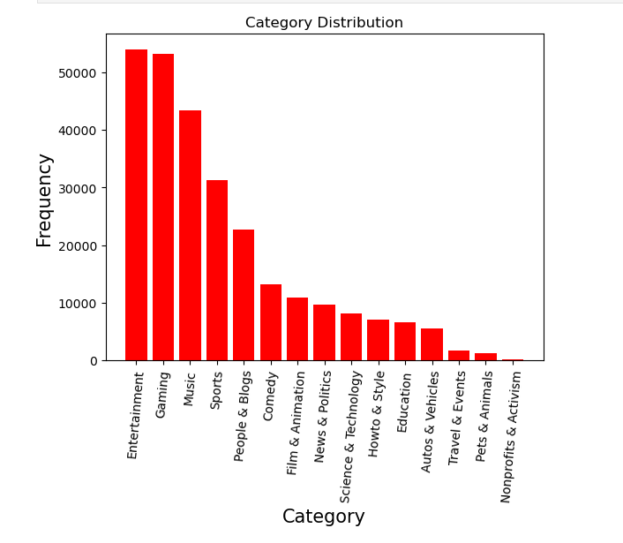
Most Frequent Category
This graph was made using the trending videos csv. data.
Depicts the most frequent genre or category that was in the trending charts for the year 2020.
Entertainment though being a very broad genre the main ways youtube categorizes this is, celebrity interviews, movie and TV show reviews, and other entertainment-related content from industry insiders and enthusiasts.

Slide 7
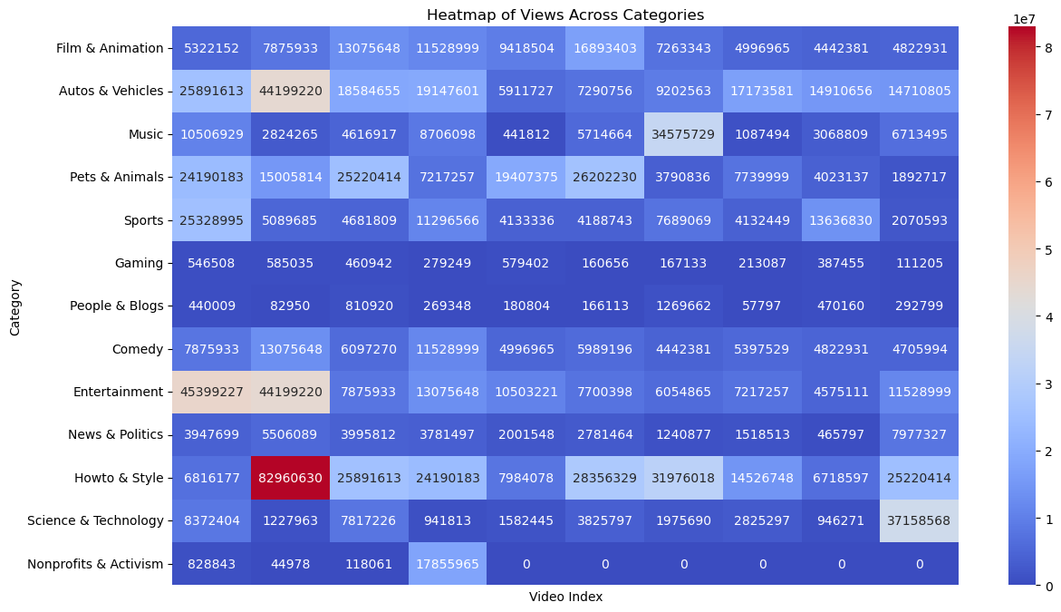

Slide 8
Heat Map Analyzation
Observations
Takeaways
Takeaways
Nonprofits and Activism seem to be the least popular videos
Entertainment seems to be the most popular category
Autos and Vehicles, Music, Howto & Style seem to constantly enter the upper echelon
Howto & Style has the most popular video
Entertainment is consistently the most watched
Nonprofits and Activism don’t garner enough attention to consistently break into the Youtube most popular videos section
This was recorded as of 8/11/24

Slide 9
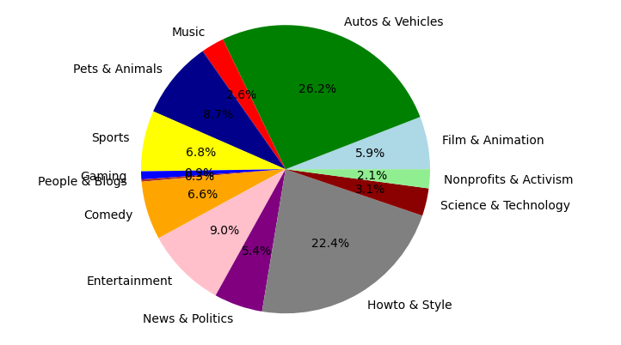
Most Frequent Category as of 8/11/24
The pie chart shows the variety of videos people watch on YouTube. Categories like "Autos & Vehicles" and "Howto & Style" are very popular. Other types, like "People & Blog" or "Gaming," have fewer videos. Knowing what’s popular helps creators make videos that more people want to see and find areas where there aren’t as many videos

Slide 10
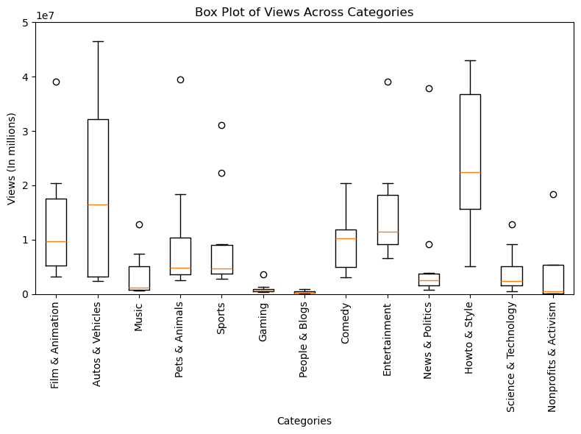
Most Frequent Category as of 8/12/24
The box and whisker plot shows the typical number of views you can expect for different types of videos. It also points out any videos that got way more or way fewer views than usual.
What's interesting is that the top category for views isn't always the same—it changes depending on the day we check. This means that what’s popular on YouTube can shift daily, influenced by what’s currently trending or happening in the world.

Slide 11
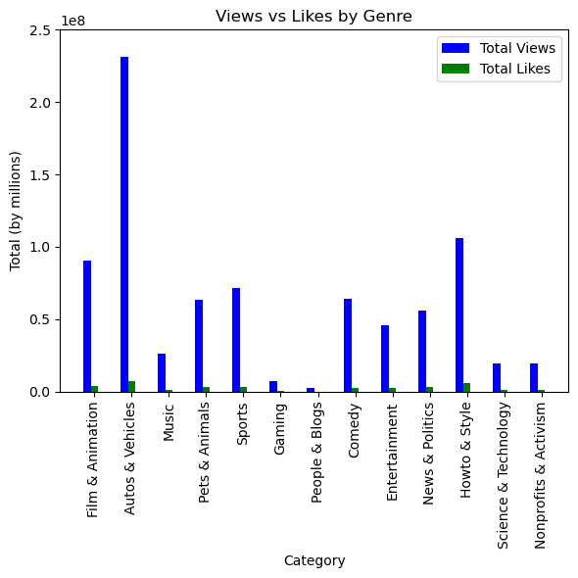
View vs Likes by Genre as of 8/12/24
Likes are a very important part of determining a Youtube video’s success and the more likes a video gets the more likely it is to be successful

Slide 12
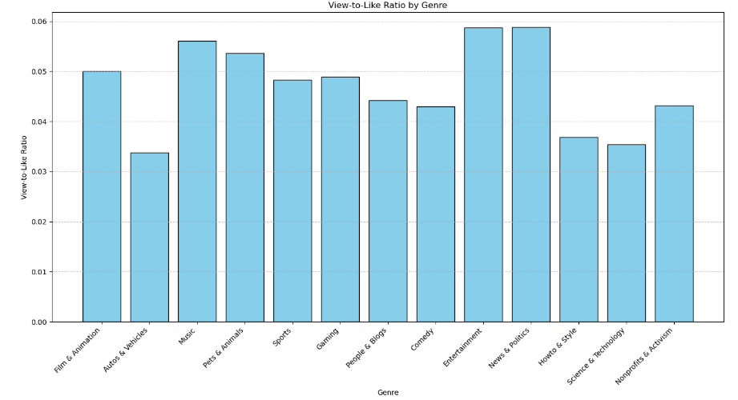
View to like ratio as of 8/11/24
What does this mean?
Videos that make the biggest impact on someone result in them liking the video so determining which videos have the highest view-to-like ratio can help us determine the most impactful genre here
The difference between the genres seems so small as to be inconsequential, however due to the thousands of videos analyzed, we argue that even the smallest difference in this category makes the biggest difference

Slide 13
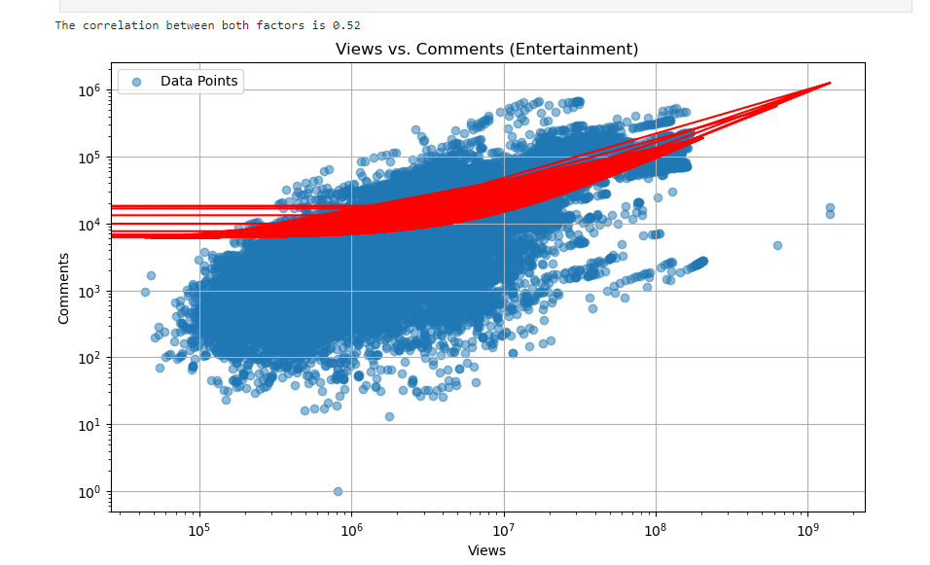
Views Vs. Comments
This slide is a depicting how many comments a video gets based on how many views a video receives
Comments are said to help to boost viewership within the Youtube algorithm so analyzing the relationship between the two helps to affirm this belief

Slide 14
Limitations
-The Youtube API doesn’t allow us to search for the most popular videos on a specific date, only today, and this is a huge limitation as the most popular videos of today may not be reflective of the actuality of the trends within Youtube
- Another interesting metric to analyze would’ve been to see the trends of certain genres over time but due to the aforementioned limitation, this isn’t possible given the current data
- The Youtube API also gives you a very small number of API requests so our data was limited to this small number, and the smaller the data, the more room there is for inconsistencies
-It may not be a limitation but it is worth noting that our data changes by the day

Slide 15
Conclusion
-As we expected there is a large amount of variety within the popularity of different Youtube genres
- However, due to conflicting data from our datasets, we believe that a large part of what determines a video’s success is instead the video itself, not the genre, some genres are more likely to succeed when compared to other (Entertainment vs Nonprofit), but ultimately it is on the quality of the video itself
-What’s even more interesting, every day that we gather data there’s differences between the most popular genres so it’s difficult to even determine what the most popular genre is, we do have an idea of the top three most popular genres though these are
Autos and Vehicles
Entertainment
Howto & Style

Slide 16
Questions
Any further questions on this topic!?
Thank You!

